Slide 1
Report for Card Decline

Slide 2
Notes:
Write everything,
Think of what are the follow up questions,
Other aspects
Practic Oral Also Prepare for quesitons targeting my code

Slide 3
Outline Needed?
Before Start
Understand the target and business challenges
Start
Check Available data and see what kind of direction we can go for
Validate Data so that they can be used confidently
Get general information about the data, plot, distribution
Examination For the problem
Result
Further Steps that can be done / Suggestions

Slide 4
Study the topic
Currency Type
Transaction Amount
Country of Transaction
Timing of Transaction
User Related Problem (Wrong Pin, CVV, no Fund, Expired)
Bank Related Problem (Communication, Error, Failure)
Fraud (Stolen / Lost Card)

Slide 5
Data Exploration
Column
external_ref
status | True
source | GLOBALPAY
ref
date_time | ISO 8601 Format
state | Accepted/Declined
cvv_provided | True/False
amount
country
currency
rates | Used for conversion
Explore the data
1 Negative Transaction
No empty cell
Each Country only uses one currency
Overall Acceptance Rate: 69.6
Date_time contains same 5 time points each day
Amount of data for each country is the same
Notes:
What's the meaning behind each finding, how do they help with analysis later

Slide 6
Data Exploration
Explore the data
1 Negative Transaction
No empty cell
Each Country only uses one currency
Overall Acceptance Rate: 69.6
Date_time contains same 5 time points each day
Amount of data for each country is the same
Country | Currency
US | USD
MX | MXN
UK | GBP
FR | EUR
CA | CAD
AE | USD
Notes:
What's the meaning behind each finding, how do they help with analysis later

Slide 7
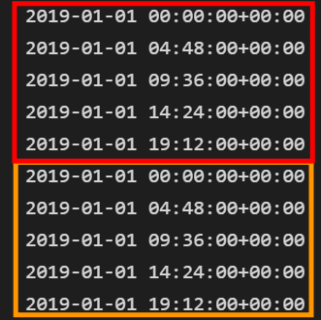
Data Exploration
Explore the data
1 Negative Transaction
No empty cell
Each Country only uses one currency
Overall Acceptance Rate: 69.6
Date_time contains same 5 time points each day
Amount of data for each country is the same
Notes:
What's the meaning behind each finding, how do they help with analysis later

Slide 8
Analysis

Slide 9
Analysis Process
Variable related to the study earlier
Timestamp
Transaction Amount
Country
Currency
CVV
Combination of variables
Further analysis based on findings
Notes:
What's the meaning behind each finding, how do they help with analysis later

Slide 10
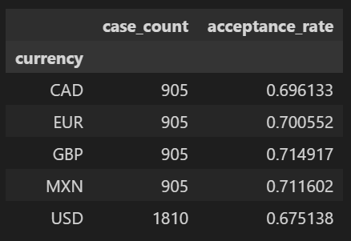
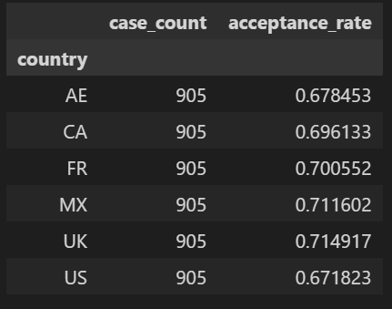
Currency / Country Related Exploration
By Currency
By Country
Notes:
Acceptance is turned using Binary number 0 and 1, so its easy to use mean to get the acceptance rate
- Country AE, US has low rate
- Currency USD has low rate
- Cant decide if AE, US (country) problem or USD (currency) problem
- Also the Acceptance rate is not that low (less than 5% change to the higher one, so we need furthur investigation

Slide 11
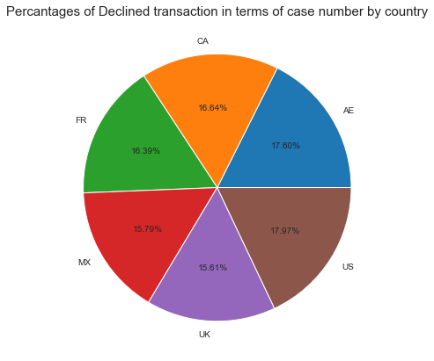
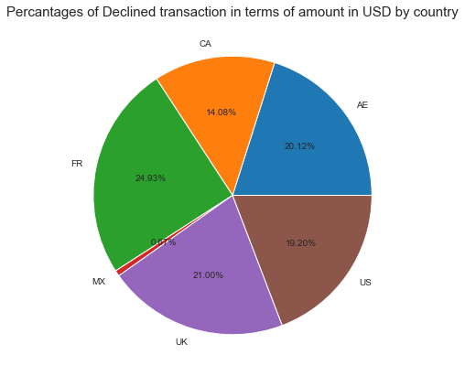
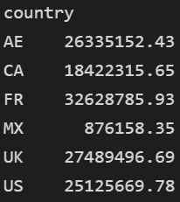
Declined cases shared rather evenly by countries
France has high total declined value
Notes:
France has high amount of decline USD, we need to see if it is directly related to our revenue, if it is, maybe we can set a priority on france

Slide 12
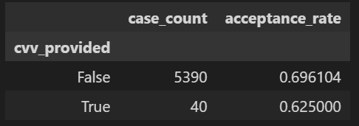
Whether CVV is provided
CVV is provided : Lower Acceptance Rate
Related Scenario : New Member? Card? First Transaction?
Cases count is too low to represent the whole dataset
Notes:
Not sure what is the scenario (new member?, first transaction?
Maybe its related to key error such as pin and CVV

Slide 13
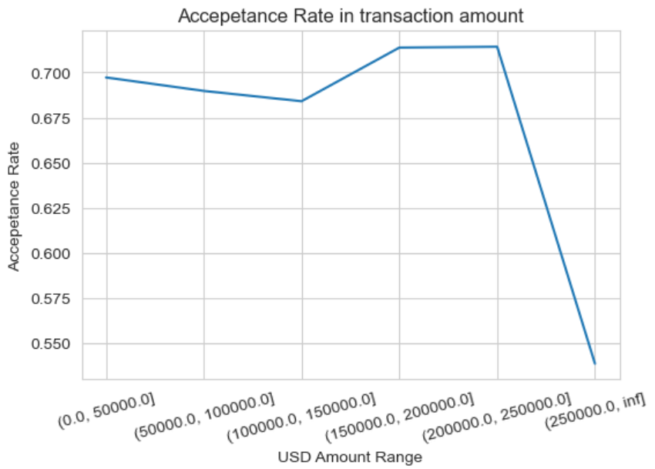
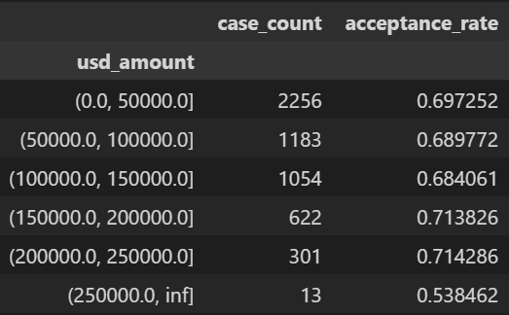
Amount of Transaction
Acceptance rate does not change significantly when the transaction amount goes up
Notes:
Though big number has low acceptance_rate, there are only 13 cases

Slide 14
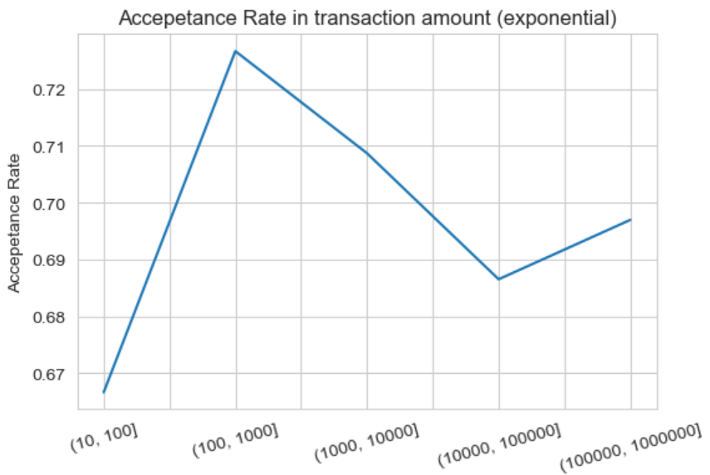
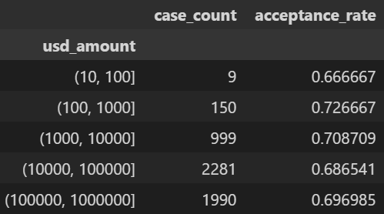
Amount of Transaction (Exponential Plot)
Acceptance rate does not change significantly when the transaction amount goes up
Notes:
It doesn’t seem like the bigger the amount the lower the acceptance rate

Slide 15
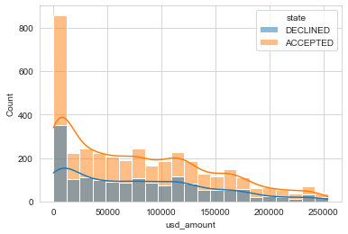
Distribution of the Cases in Different State
The ratio of declined cases to accepted cases are similar throughout different transaction amount
Notes:
Overall rejection is at the same ratio to accepted cases through out all the usd amount

Slide 16
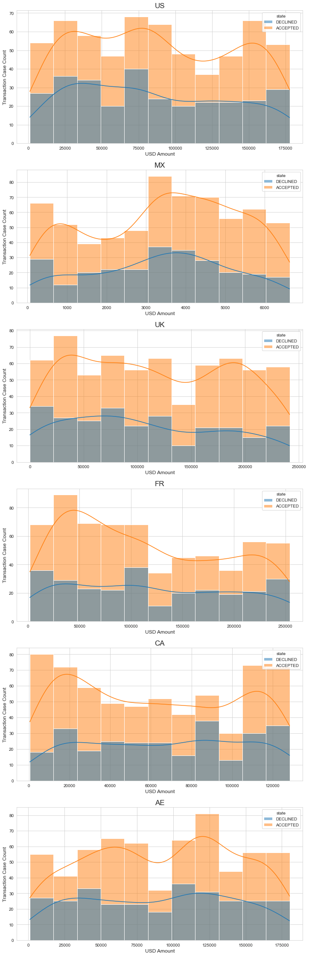
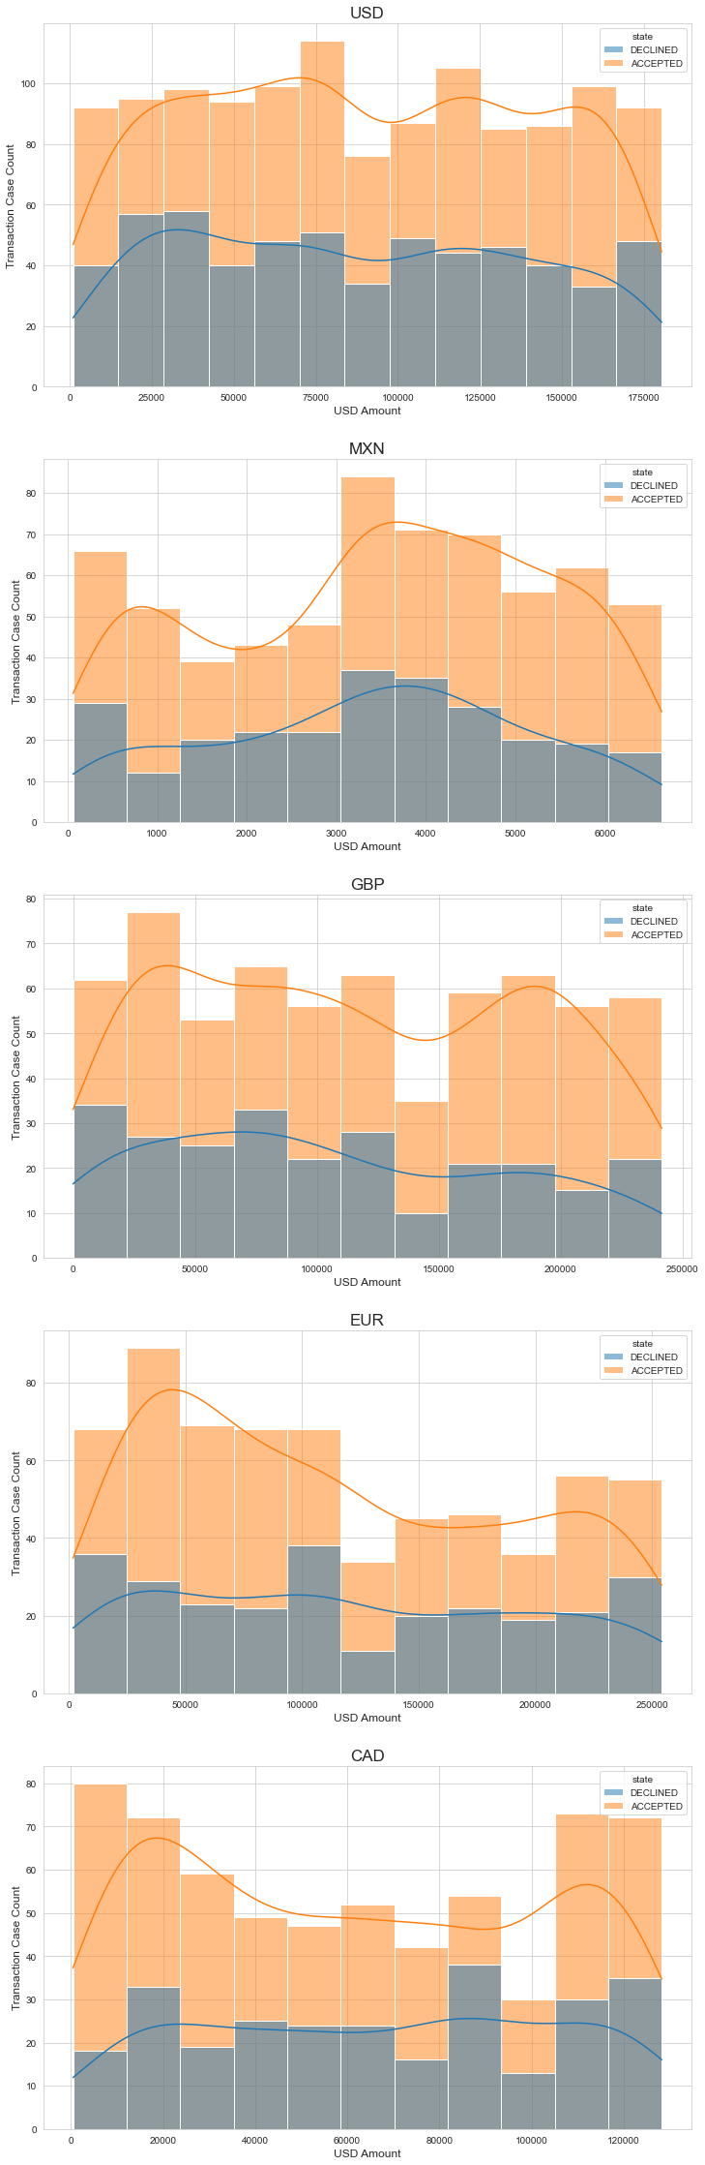
Distribution of the Cases in Different State
By Country
By Currency
Motivation: to see if there is abnormal behavior in certain country/currency
Notes:
Rejected case seems to be equally distributed in different amount range regardless of the currency or country
It can be said that the rejection reason is beyond currency and country

Slide 17
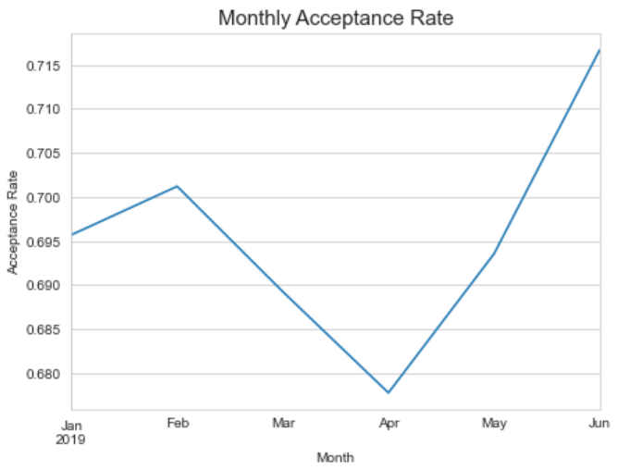
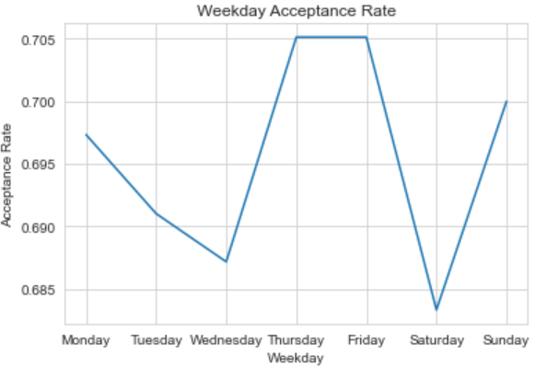
Acceptance Rate in Relation to Time
April has the lowest acceptance rate
Wednesday & Saturday
Overall the change between different time is not drastic
Notes:
Want to see if there is a special time where acceptance rate is really low

Slide 18
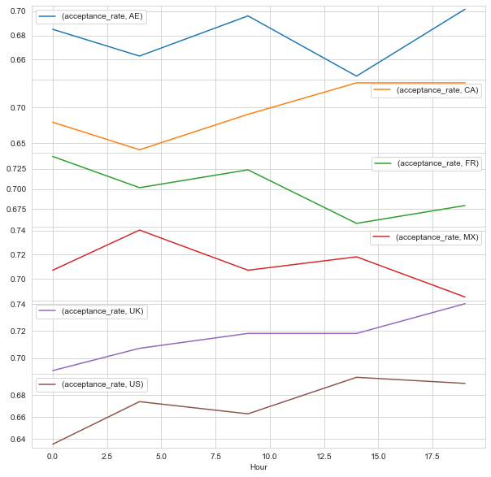
Each Country’s Acceptance Rate by Hour
Maximum 4% Change
Only 5 timepoints each day
UTC + 0 Time
Might need to convert to local time
Notes:
Interesting, each country has at least 4 % change throughout the hour
The timepoint is not fine grained enough, with only 5 time points its hard to pinpoint the change
Also not sure if the time points matches directly with the transaction time, because there are always the same 5 time points
utc iso-8601 with zero off set, so its based on UTC +- ZERO, might be interesting to convert the time to local time to see if there is a trend
I brifely did it but im not so confident with the result so I deleted (because of the questions on why there are only 5 exact timestamp and that the time might not reflect the real time). But that being said, the change of hour only affect 4% of cases. The reason for majority of rejection is hard to pinpoint. I don’t know if 4 percent is important in terms of the matter, also there is no universal pattern here as each country shows different result. Maybe insight should be extract based on the country?

Slide 19
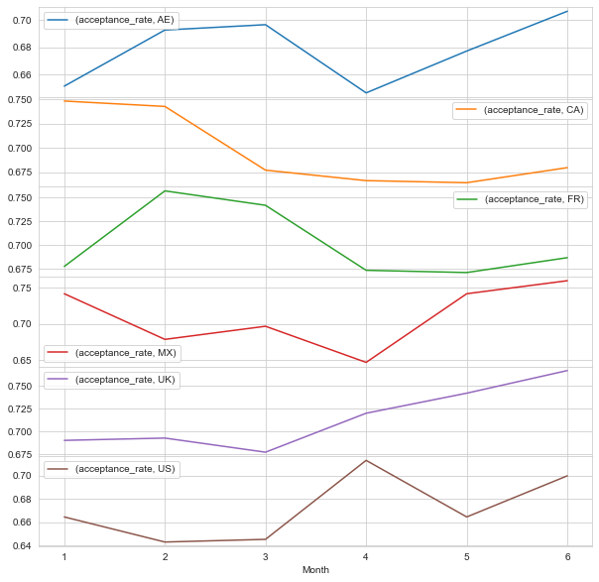
Each Country’s Acceptance Rate by Month
 | Highest | Lowest | Avg | High - Low
AE | 70.7 (6) | 64.7 (4) | 67.9 | 6
CA | 74.8 (1) | 66.5 (5) | 69.7 | 8.3
FR | 75.7 (2) | 67.1 (5) | 70.1 | 8.6
MX | 76 (6) | 64.7 (4) | 71.1 | 11.3
UK | 76.7 (6) | 67.8 (3) | 71.5 | 8.9
US | 71.3 (4) | 64.3 (2) | 67.2 | 7
May and April for AE, CA, FR, MX
February and March for UK, US
(External and internal events)
Notes:
Should plot it better to let the point stop in the middle of the month for better understanding
Overall majority of the country has low acceptance rate in April except US and UK,
Might need to check what is the event at that time, related to company or external events
But from the current data we cant get more info for that

Slide 20
Compare with the Average USD Amount By Month (If clients are recurrent)
country | Month | Average USD Amount | Case Count
AE | 1 | 16885.267484 | 155
 | 2 | 47508.311643 | 140
 | 3 | 75625.163935 | 155
 | 4 | 109413.584533 | 150
 | 5 | 133649.639742 | 155
 | 6 | 165310.796933 | 150
CA | 1 | 9914.889136 | 155
 | 2 | 26933.970184 | 140
 | 3 | 49451.406143 | 155
 | 4 | 74631.831070 | 150
 | 5 | 99203.972984 | 155
 | 6 | 120082.852860 | 150
FR | 1 | 19603.206564 | 155
 | 2 | 48628.860056 | 140
 | 3 | 85923.569995 | 155
 | 4 | 126686.930616 | 150
 | 5 | 182761.553443 | 155
 | 6 | 233937.775001 | 150
MX | 1 | 586.470149 | 155
 | 2 | 1877.747643 | 140
 | 3 | 3132.959629 | 155
 | 4 | 3955.839695 | 150
 | 5 | 4875.976420 | 155
 | 6 | 6009.340632 | 150
UK | 1 | 16623.520678 | 155
 | 2 | 50255.721007 | 140
 | 3 | 86670.945996 | 155
 | 4 | 128500.033073 | 150
 | 5 | 178093.413481 | 155
 | 6 | 219711.956027 | 150
US | 1 | 16484.493613 | 155
 | 2 | 40432.892857 | 140
 | 3 | 68526.028839 | 155
 | 4 | 95491.579867 | 150
 | 5 | 132111.739097 | 155
 | 6 | 164020.860267 | 150
 | Highest | Lowest | Avg | High - Low
AE | 70.7 (6) | 64.7 (4) | 67.9 | 6
CA | 74.8 (1) | 66.5 (5) | 69.7 | 8.3
FR | 75.7 (2) | 67.1 (5) | 70.1 | 8.6
MX | 76 (6) | 64.7 (4) | 71.1 | 11.3
UK | 76.7 (6) | 67.8 (3) | 71.5 | 8.9
US | 71.3 (4) | 64.3 (2) | 67.2 | 7
Potential Threshold
FR, AE : 100,000 USD
MX : 1500 & 4000 USD
Red: Low Acceptance Rate
Notes:
This can not be reflected by the distribution plot because after they reach the threshold the later month can still contribute to success in the threshold bin
If clients are not recurrent, (namely whatevery above the threshold will be checked really hard), then everything higher than threshold should have low rate, but instead, once past the threshold the AR can bounce back, suggesting the history is at play if the clients are recurrent

Slide 21
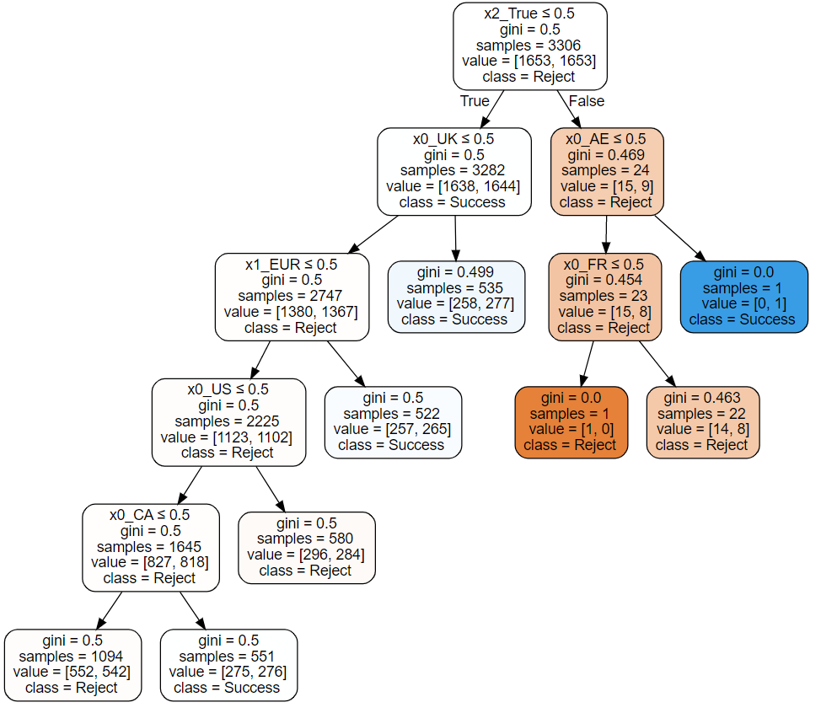
Decision Tree
X0 : Country
X1 : Currency
X2 : CVV Provided
Data is balanced
Only for support
 | Data (5430)
Accept | 3777 (69.6%)
Reject | 1653 (30.4%)
Notes:
Accuracy is only 50.8%, meaning the given feature is not really good at explaining the reason behind the result
If not balanced the, 69.6% is given, same as the rate of accept cases, meaning using the current feature decision tree cannot split accept and reject apart, namely the current feature cannot really explain the result well. (most leaves are just labelled as success anyway)
Drop to balance data is aim to let reject cases have more power in splitting the nodes.
The conculsion here is that these features are hard to account for the majority of the rejected cases.
The above only serve as support for current findings.
Further thing to do is to transform date time espeically month or hour into feature for the decision tree, or convert the usd amount into discreet group for addition feature, but their relation to whether cards are accept or declined has been illustrated in the previous plots

Slide 22
Suggest Solution / Further Investigation
Check More Factors
Credit Debit Type
Error Code
Foreign Status
Payment Method
Type of card
Transaction Local Time
Check the change within the same clients
Time Related
Check if there is a relationship between transaction amount and the low acceptance rate hour
Check if there is an external, internal (feature changing, end of promotion, group of new clients) event in the month where low acceptance rate happens
Might also need to check based on different countries
Notes:
What’s the purpose of customers performing this transaction with Deel? Where will they plan to eventually use the fund for? It might give me more intuition on what kind of transaction behavior are normal and what are not.
How do people usually perform the transaction, is it an internet web app? for the reason similar to the above question?
Why are there only 6 repetitive timestamps throughout the dataset? This might let me know more about the mechanism on globepay and determine whether the timestamp is a reliable information to be used for analysis.
Why does every country have the same amount of data?
What is the scenario where CVV is not provided?
Is there an identifier to see if two transactions belong to the same person? Are customers recurrent in this scenario?

Slide 23
Suggest Solution / Further Investigation
Check reasons related to bigger purchase, for example credit limit, retry if it works
Check More Factors
Credit Debit Type
Error Code
Foreign Status
Payment Method
Type of card
Transaction Local Time
Check the change within the same clients
Time Related
Check if there is a relationship between transaction amount and the low acceptance rate hour
Check if there is an external, internal (feature changing, end of promotion, group of new clients) event in the month where low acceptance rate happens
Might also need to check based on different countries
Notes:
What’s the purpose of customers performing this transaction with Deel? Where will they plan to eventually use the fund for? It might give me more intuition on what kind of transaction behavior are normal and what are not.
How do people usually perform the transaction, is it an internet web app? for the reason similar to the above question?
Why are there only 6 repetitive timestamps throughout the dataset? This might let me know more about the mechanism on globepay and determine whether the timestamp is a reliable information to be used for analysis.
Why does every country have the same amount of data?
What is the scenario where CVV is not provided?
Is there an identifier to see if two transactions belong to the same person? Are customers recurrent in this scenario?

Slide 24
hypothesis / analysis
If it is related to time
Month
Day Time Hour
Build a model to predict whether the trasaction will be successful or not, if not, suggest the client with old method that once succeed
Use previous few days issuer acceptance rate as input
Time and day when transaction happened
The amount
Create different experience if declination might be detected
Ask for old way
Ask to provide itendification
Approve transaction and perform retry later if for sure the card is good (in a safe range), to improve user experience (good for when inner system is down)
Check expiry date and remind the user to update the card information
Notes:
I don’t think we can get the fund information from the user, so we cant remind user for that
Our goal is to improve revenue or increase user experience
https://medium.com/paypal-tech/using-machine-learning-to-improve-payment-authorization-rates-bc3b2cbf4999

Slide 25
If 4 percent of transaction the data getting rejected is important, then we can go for month, hour analysis because they explain roughly 4 percent of the data. but we still need to find a pattern, such as are low rate hour universal? Or low rate month universal? (currently they are not)

